Slide 1
Welcome!

Slide 2
Problem
What time is it?

Slide 3
12:30
IS IT?

Slide 4
NO!
IT’S LUNCH TIME!

Slide 5
A three-course meal in PCG
Jorge Palacios
AI Programmer, Freelancer
@pctroll

Slide 6
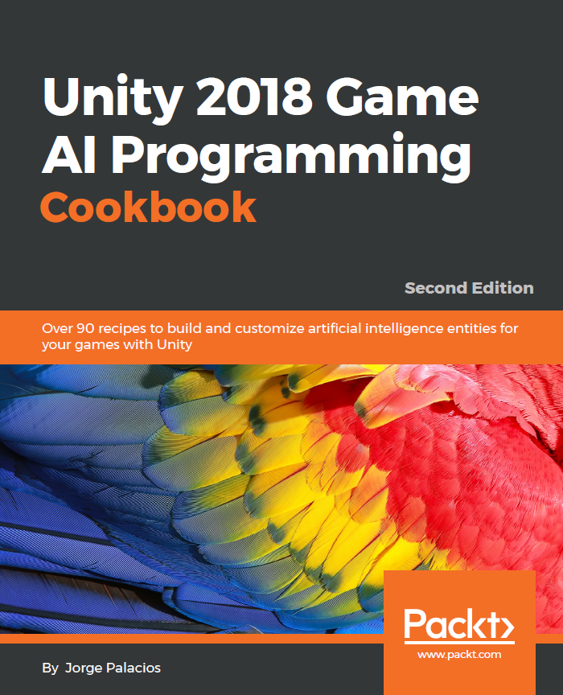
About me
B.Sc. Computer Science
Ms. Computer Science candidate
Author
Drummer
Rocket League lover
Love teaching/sharing

Slide 7














Experience

Slide 8
Introduction

Slide 9
Introduction

Slide 10
P
PROCEDURAL
C
CONTENT
G
GENERATION

Slide 11
Problem
Why do we need/want PCG?

Slide 12
Problem
More hours of play.
Same/less budget

Slide 13
Evolving enemies through
Genetic Algorithm

Slide 14
Problem
We’d like to have adaptive enemies

Slide 15
The Solution
Enter Genetic Algorithm

Slide 16
Genetic Algorithm
in a nutshell
Create initial population (and shuffle them if necessary)
Evaluate individuals and keep the fittest
Generate new offspring from survivors, and mutate them a little

Slide 17





Genetic Algorithm
in a nutshell

Slide 18
Genetic Algorithm
Initialize population of μ + λ individuals
Shuffle them (optional)
Evaluate all individuals with the evaluation function
Sort the population in order of ascending fitness
Remove the worst λ individuals
Replace the λ removed individuals with copies of the remaining ones
Mutate the λ offspring
If the population contains an individual of sufficient quality, or max number generation is reached, stop. Otherwise, go back to 2
Notes:
This slide is just for reference and for the assistants to keep when they download the slides

Slide 19
Editor explanation and run demo
How do we implement it?

Slide 20
Building Dungeons
using BSP

Slide 21
Problem
We’d like to have rooms connected by hallways

Slide 22
The Solution
B
S
P

Slide 23
B
BINARY
S
SPACE
P
PARTITIONING

Slide 24
Binary Space Partitioning
(the good parts)
Start with the whole area and split it in 2
Synergistically reconceptualize multidisciplinary functionalities after empowered innovation.
Keep splitting if necessary
Globally morph multidisciplinary services through strategic innovation. Scale go forward materials.
Connect cells with hallways
Objectively customize client-centric process improvements. Assertively unleash bricks-and-clicks services.

Slide 25
Editor explanation and run demo
How do we implement it?

Slide 26
Assembling new levels
with n-grams

Slide 27
Problem
We’d like to imitate a level designer’s style

Slide 28
N-gram for level generation
(or how to create a quattro stagioni)
Serialize your levels into slices
Transform those slices into an abstract version of letter, syllable, or word
Train the system using a trigram
Enjoy your freshly baked level

Slide 29
Editor explanation and run demo
How do we implement it?

Slide 30
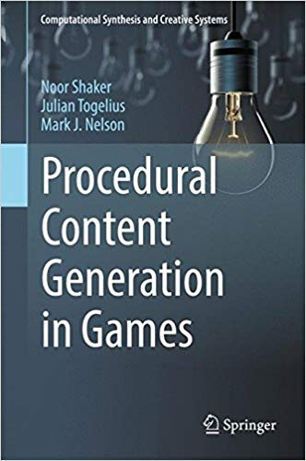

Where do we start?

Slide 31
Thank you!
¡Gracias!
Code and slides at:
github.com/pctroll/unitela2018
@pctroll - jorge@reefaktor.com
Notes:
The github repo

